Slide 2

Computer and Embedded Systems Engineering MSc Thesis
Why did Itanium fail
By K. L. Geijsen
Notes:
Intro

Slide 3
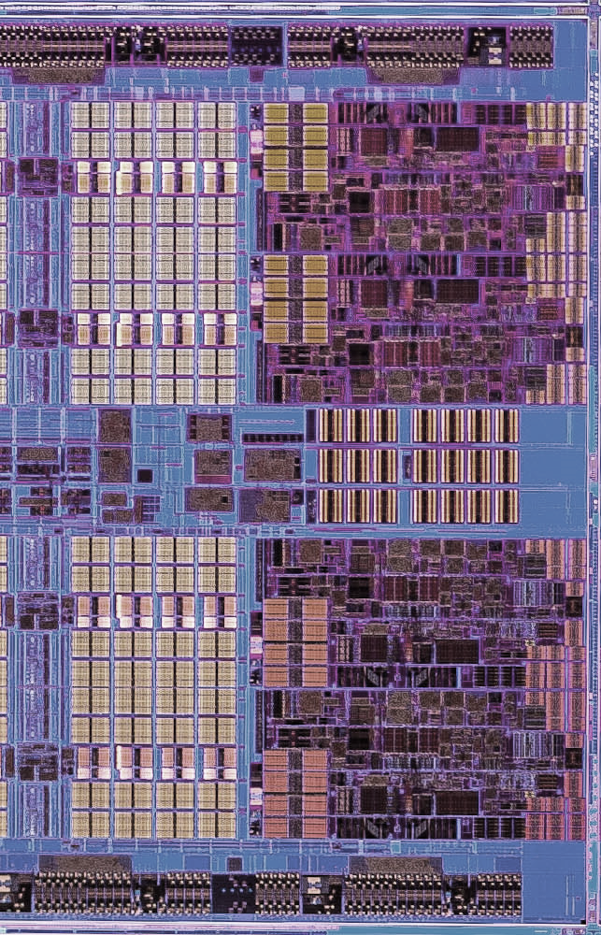
Presentation structure
MSc thesis: Why did Itanium fail?
Introduction
Summary Itanium
Failure definition
Motivation
Experiment results
Market reception
Performance comparative analysis
Static analysis of IA-64 Binaries
Hardware complexity analysis
Differentiation business strategy framework
Conclusion
Summary
Conclusion
09-10-2020

Slide 4
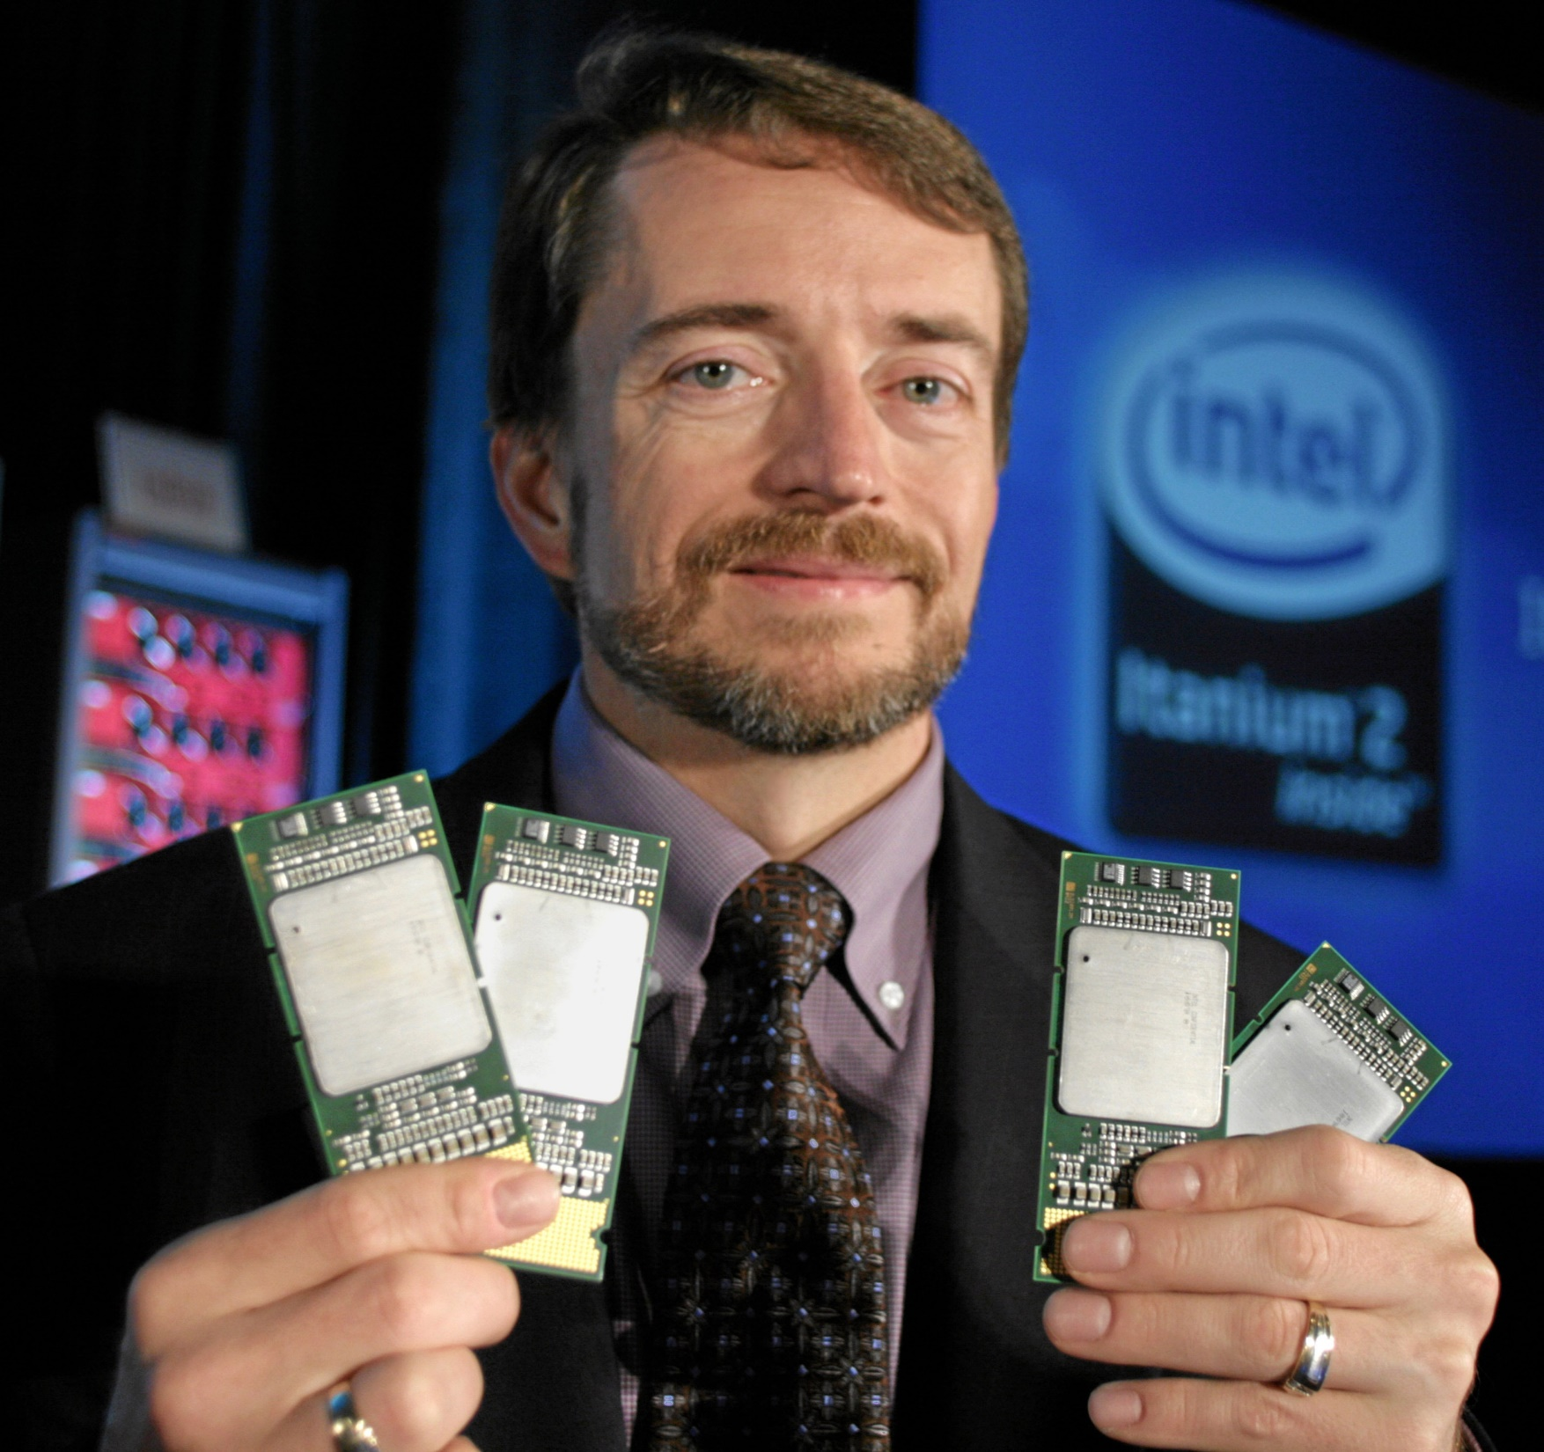
Summary of Itanium
Intel + HP joint project
09-10-2020

Slide 5
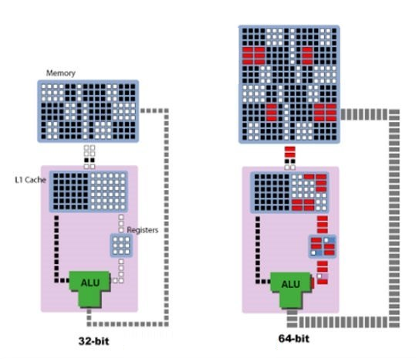
Summary of Itanium
Intel + HP joint project
64-bit architecture – IA-64
27.06.2024

Slide 6
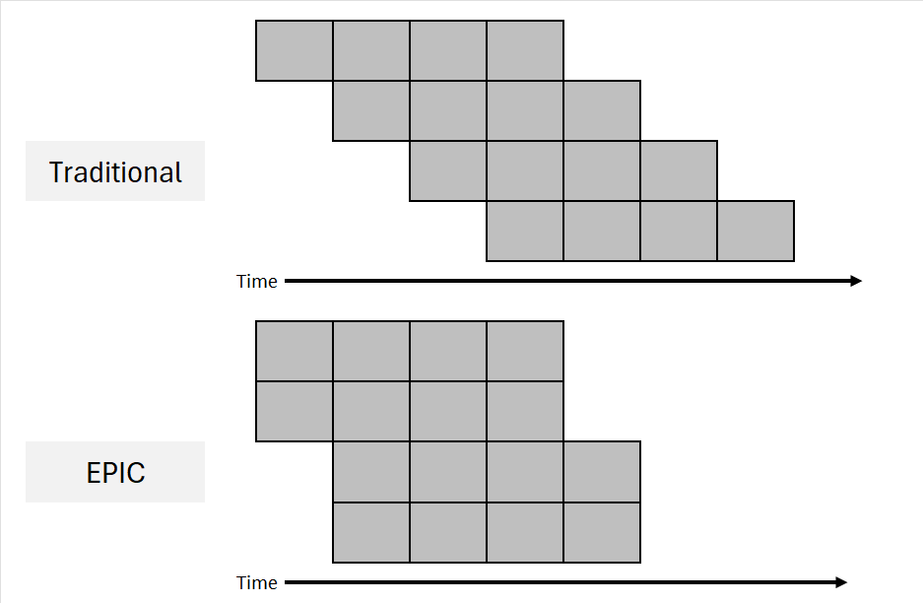
Summary of Itanium
Intel + HP joint project
64-bit architecture – IA-64
EPIC
27.06.2024

Slide 7
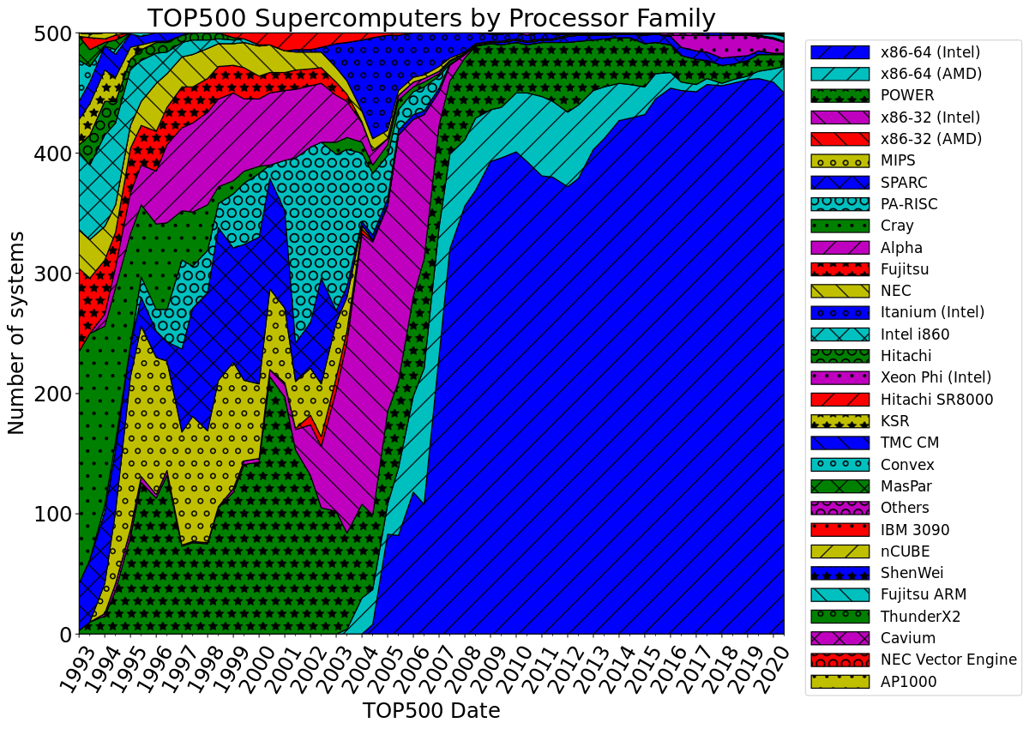
Failure definition
What were Itanium’s goals?
27.06.2024

Slide 8
Failure definition
What were Itanium’s goals?
Performance leadership (through static ILP)
Introduce 64-bit architecture
Replace x86
27.06.2024

Slide 9
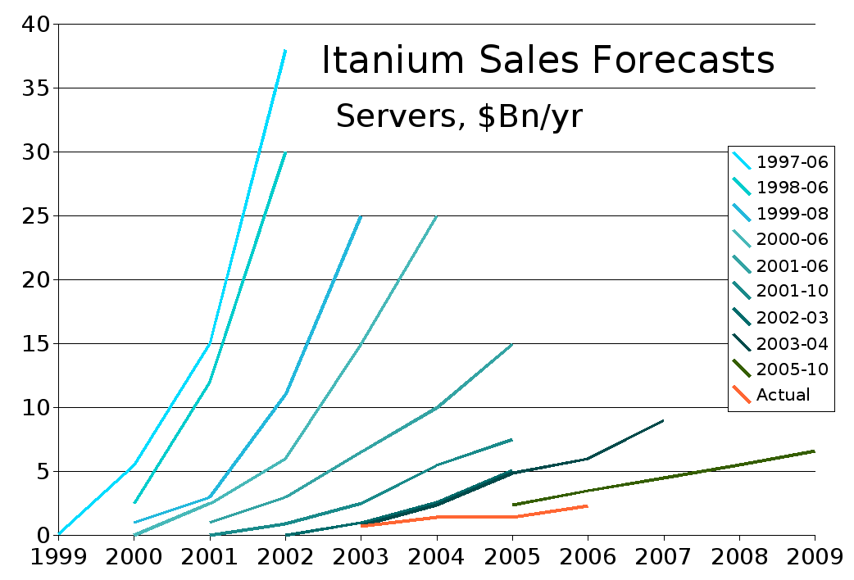
Motivation
Such a large-scale project costing billions
Intel/HP loss, but also customers and investors
27.06.2024

Slide 10
Motivation
Such a large-scale project costing billions
Intel/HP loss, but also customers and investors
No definitive answer yet
27.06.2024

Slide 11
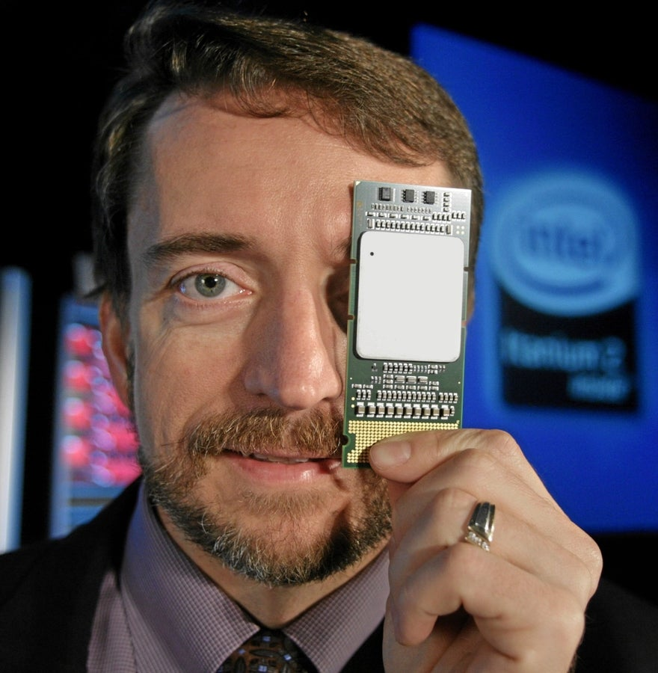
Motivation
Such a large-scale project costing billions
Intel/HP loss, but also customers and investors
No definitive answer yet
Personal interest
09-10-2020

Slide 12
Studies performed
MSc thesis: Why did Itanium fail?
Public reception
Automated sentiment analysis
Technical evaluation
SPEC performance comparative analysis
Theoretical performance comparative analysis
Static analysis on IA-64 binaries
Hardware complexity comparison
Business strategy
Differentiation strategy framework
09-10-2020

Slide 13
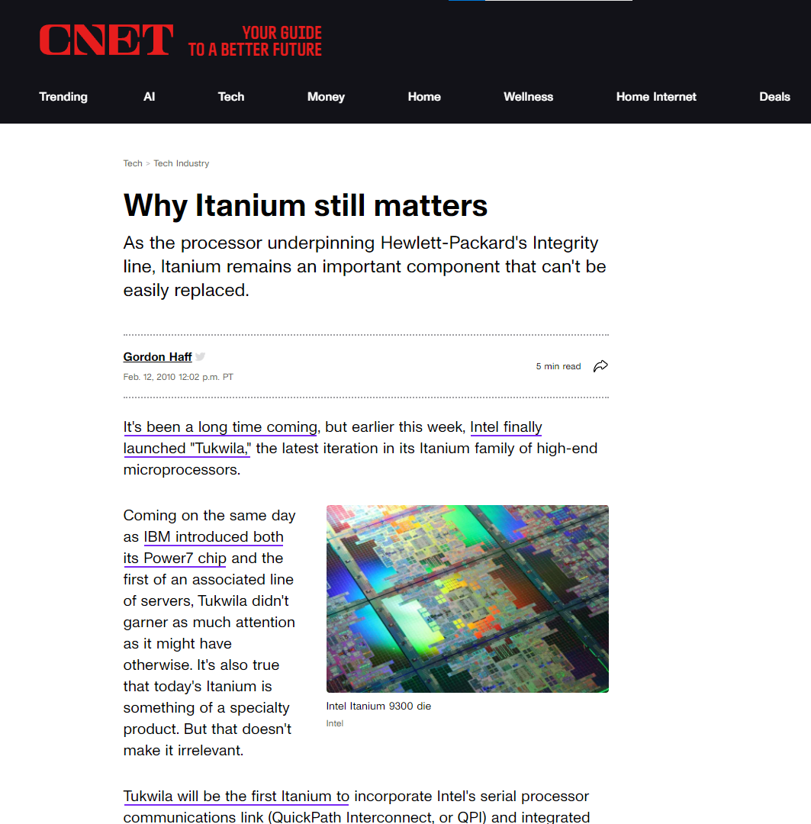
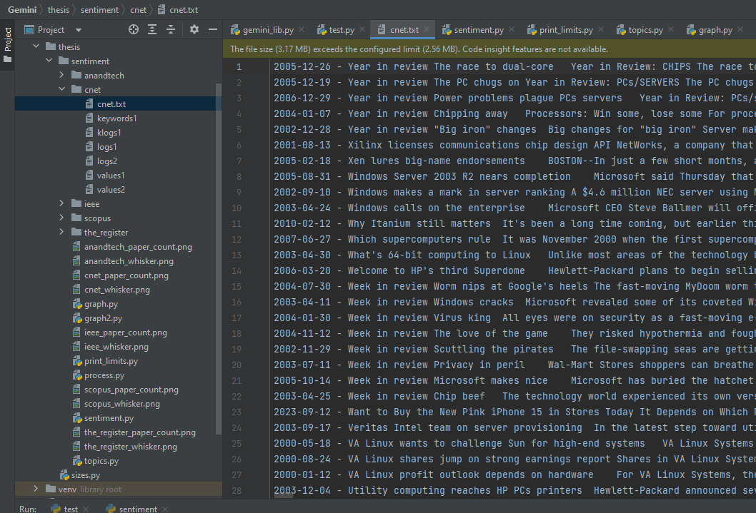

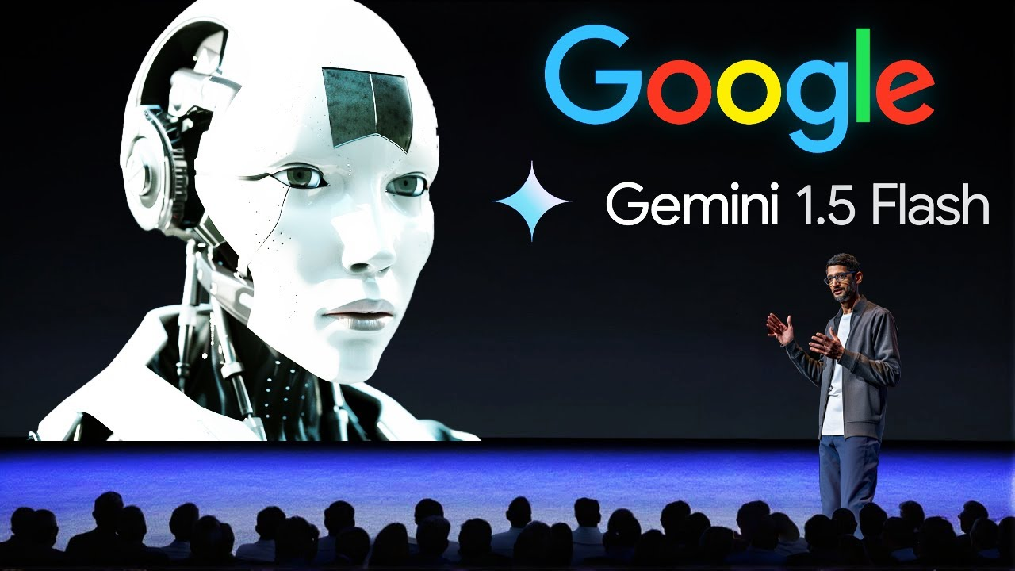
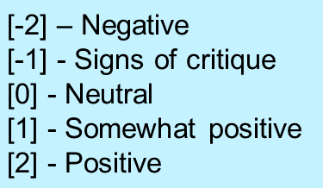
1. Automated sentiment analysis
Automated using Large Language Models
genai API
Sentiment
scores
27.06.2024

Slide 14
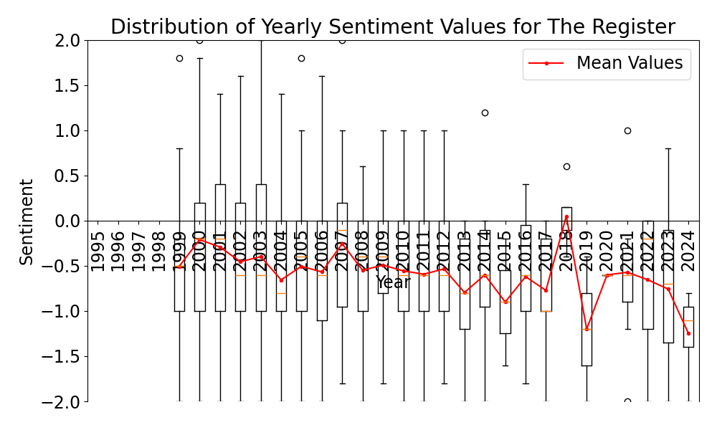
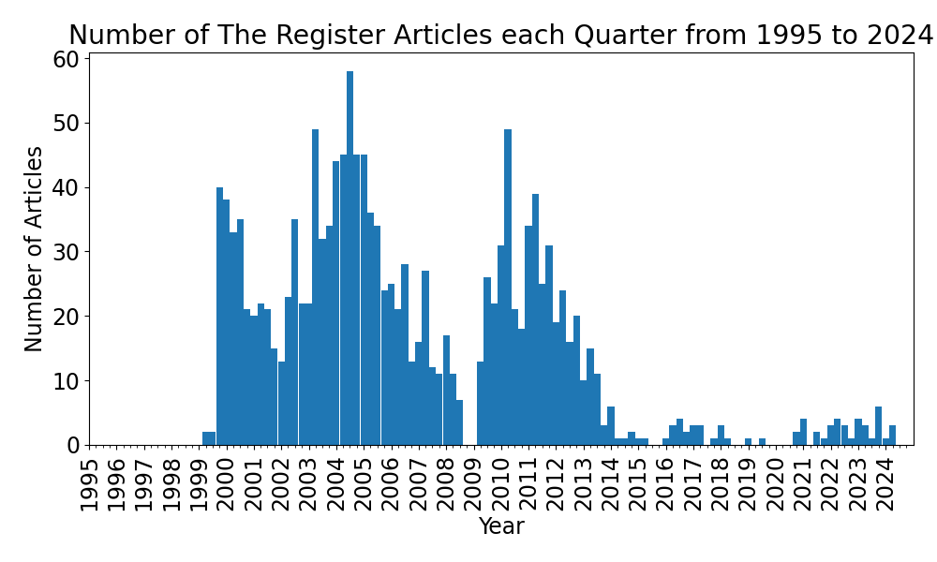
1. Automated sentiment analysis
Automated using Large Language Models
Results:
Public reception
27.06.2024

Slide 15
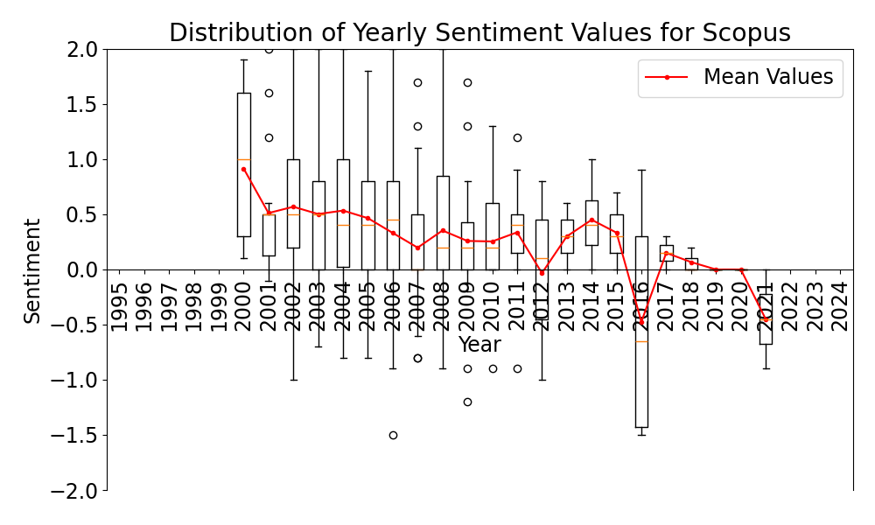
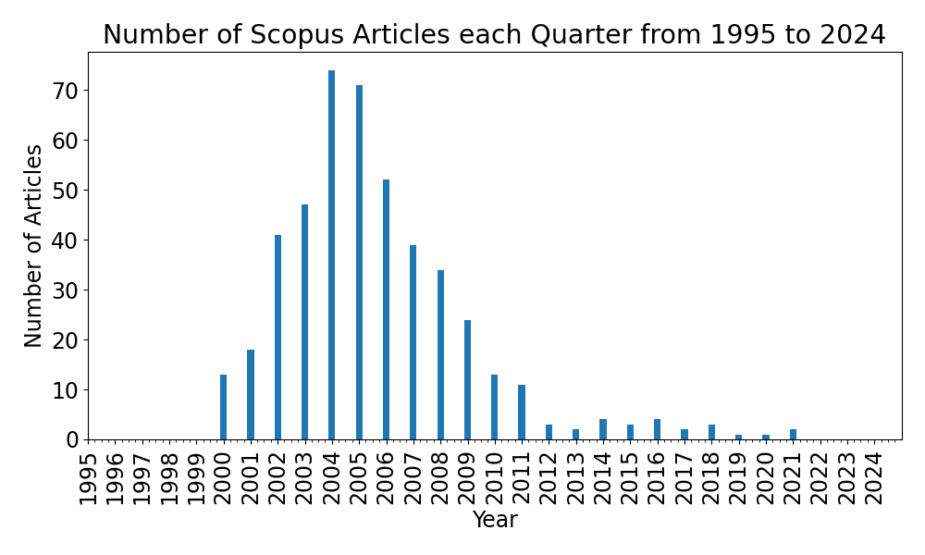
1. Automated sentiment analysis
Automated using Large Language Models
Results:
Public reception
Academic reception
27.06.2024

Slide 16
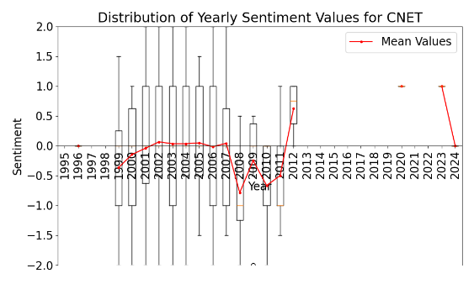
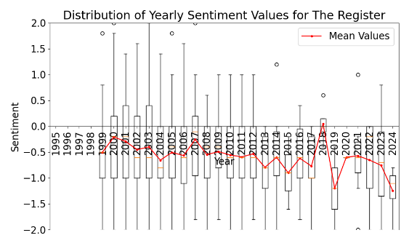
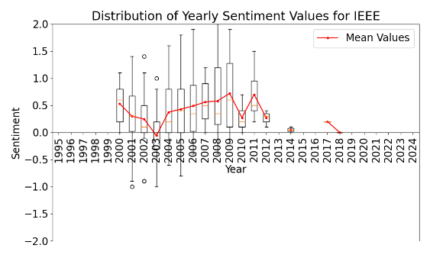
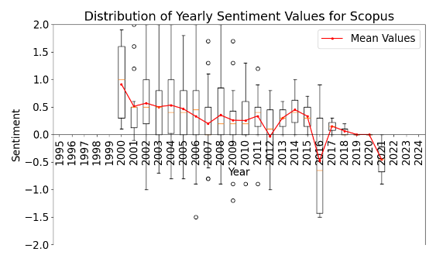
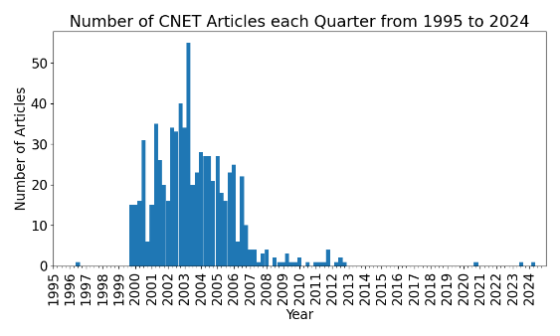

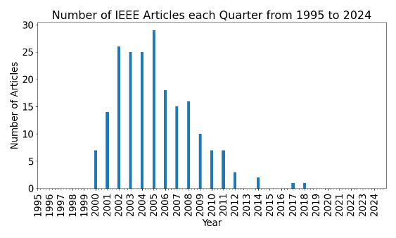

1. Automated sentiment analysis
Automated using Large Language Models
Results:
Public reception
Academic reception

Slide 17
1. Automated sentiment analysis
Automated using Large Language Models
Results:
Public reception
Academic reception
Conclusions:
Popularity peaks around 2004

Slide 18
1. Automated sentiment analysis
Automated using Large Language Models
Results:
Public reception
Academic reception
Conclusions:
Popularity peaks around 2004
Sentiment is polarized

Slide 19
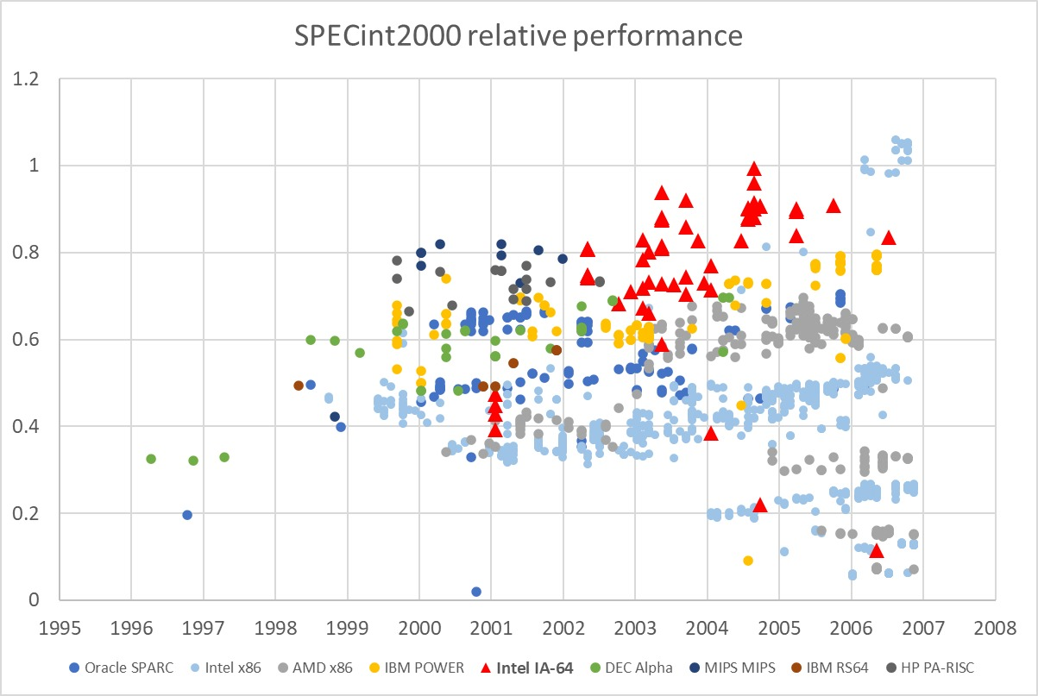
2. SPEC performance comparative analysis
SPEC benchmarks
27.06.2024

Slide 20
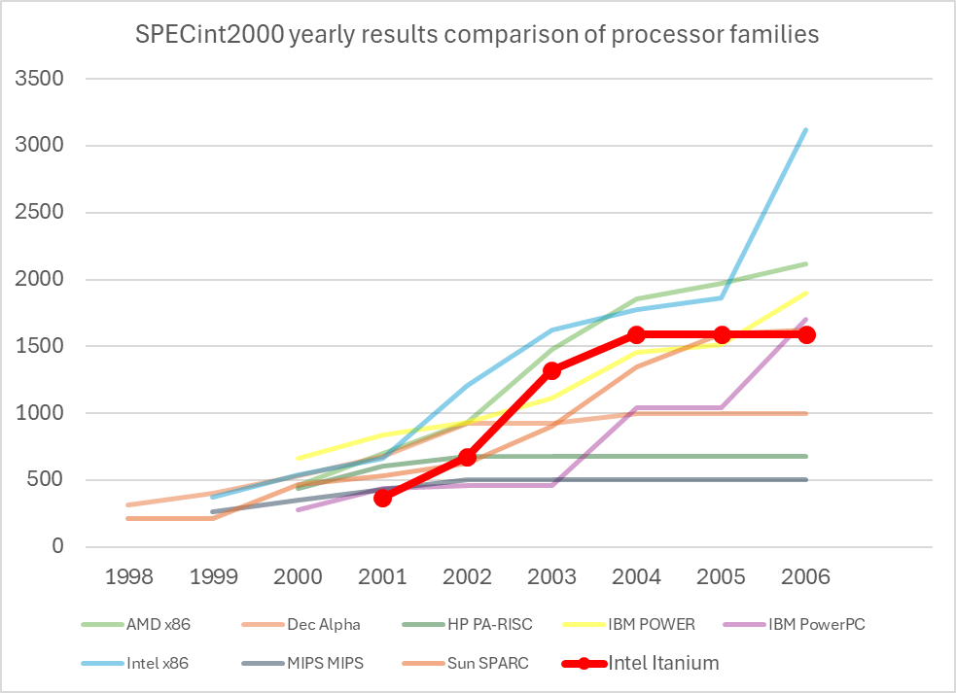
2. SPEC performance comparative analysis
SPEC benchmarks
SPECint2000
27.06.2024

Slide 21
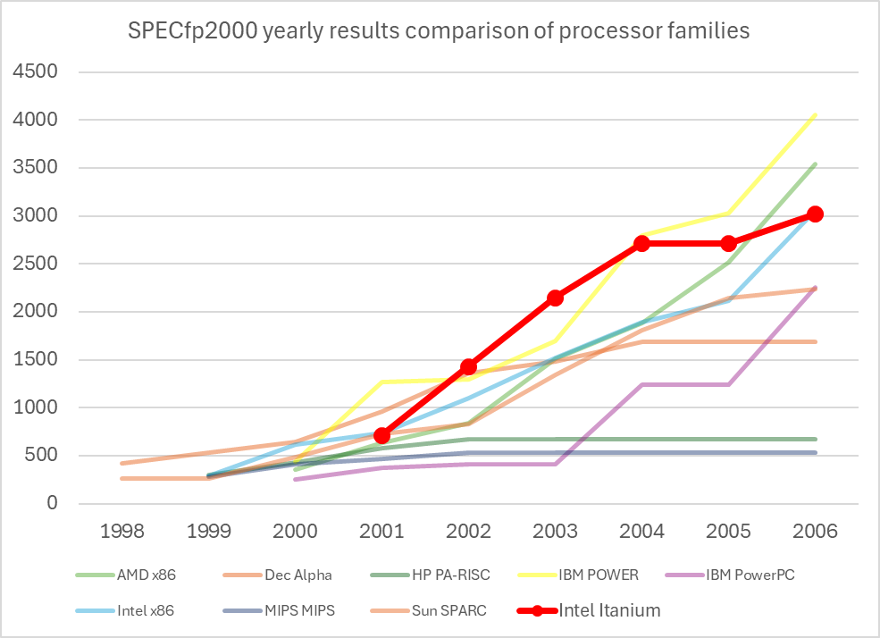
2. SPEC performance comparative analysis
SPEC benchmarks
SPECint2000
SPECfp2000
27.06.2024

Slide 22
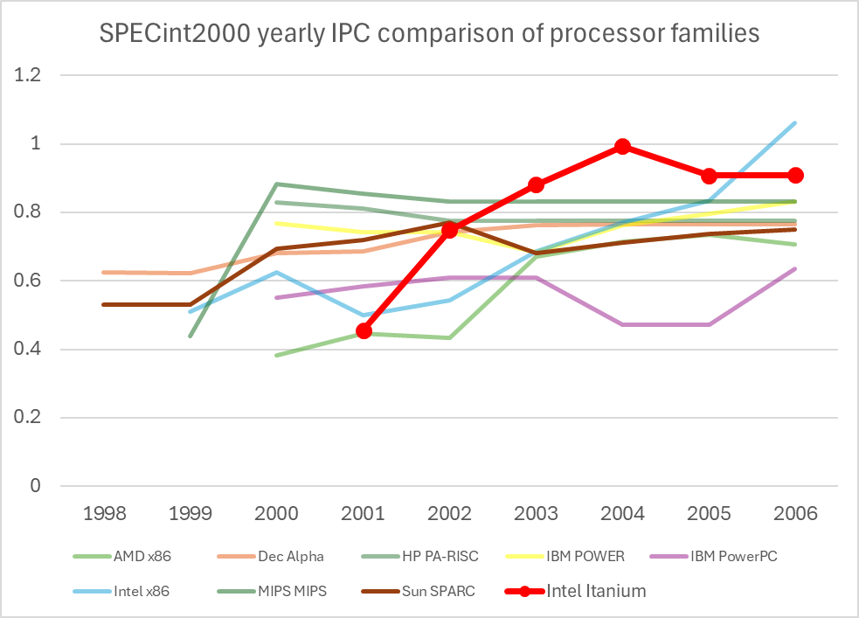
2. SPEC performance comparative analysis
SPEC benchmarks
SPECint2000
SPECfp2000
SPECint2000 normalized
27.06.2024

Slide 23
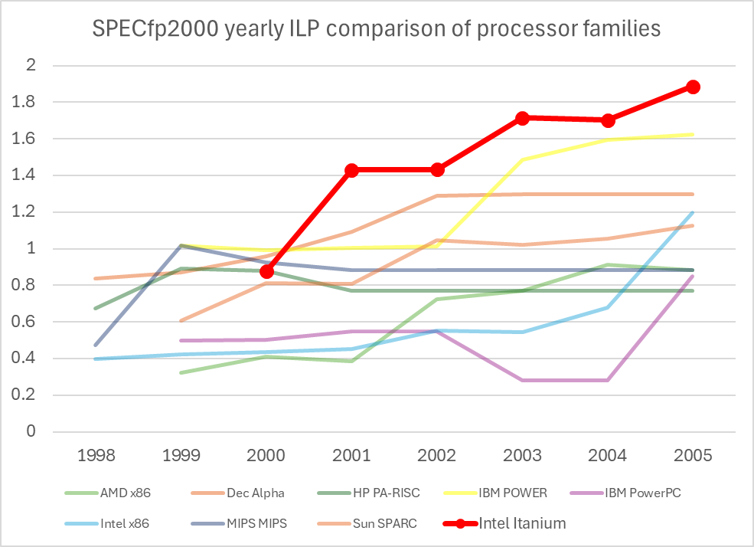
2. SPEC performance comparative analysis
SPEC benchmarks
SPECint2000
SPECfp2000
SPECint2000 normalized
SPECfp2000 normalized
27.06.2024

Slide 24
2. SPEC performance comparative analysis
SPEC benchmarks
SPECint2000
SPECfp2000
SPECint2000 normalized
SPECfp2000 normalized
Conclusions
SPEC performance is competitive
27.06.2024

Slide 25
2. SPEC performance comparative analysis
SPEC benchmarks
SPECint2000
SPECfp2000
SPECint2000 normalized
SPECfp2000 normalized
Conclusions
SPEC performance is competitive
At normalized clock speed it performs better
27.06.2024

Slide 26
2. SPEC performance comparative analysis
SPEC benchmarks
SPECint2000
SPECfp2000
SPECint2000 normalized
SPECfp2000 normalized
Conclusions
SPEC performance is competitive
At normalized clock speed it performs better
Performs best in FP workloads
27.06.2024

Slide 27
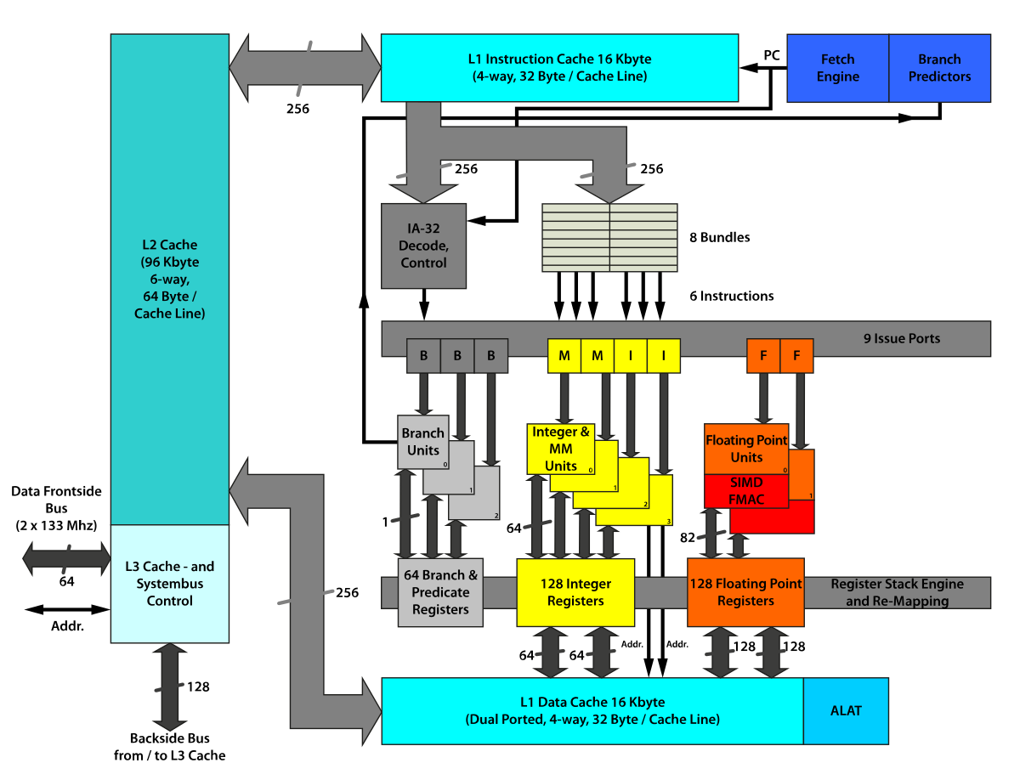
3. Theoretical performance comparative analysis
Theoretical performance limits of EPIC
27.06.2024

Slide 28
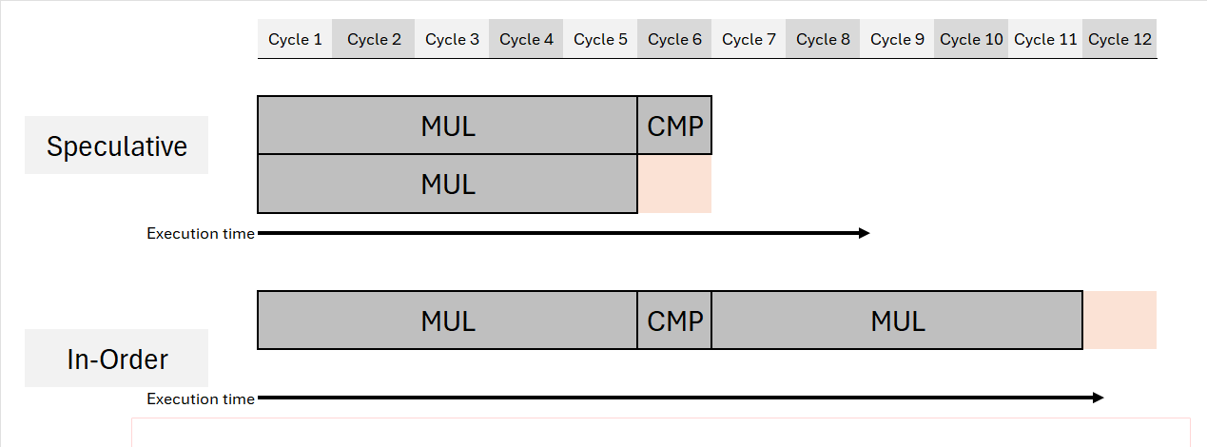
3. Theoretical performance comparative analysis
Theoretical performance limits of EPIC
Speculative execution
27.06.2024

Slide 29
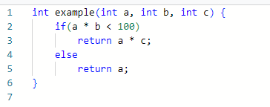
3. Theoretical performance comparative analysis
Theoretical performance limits of EPIC
Speculative execution
EPIC: Compiler chooses
Speculative?
In-order?
27.06.2024

Slide 30
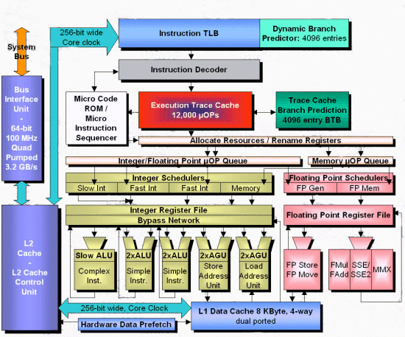
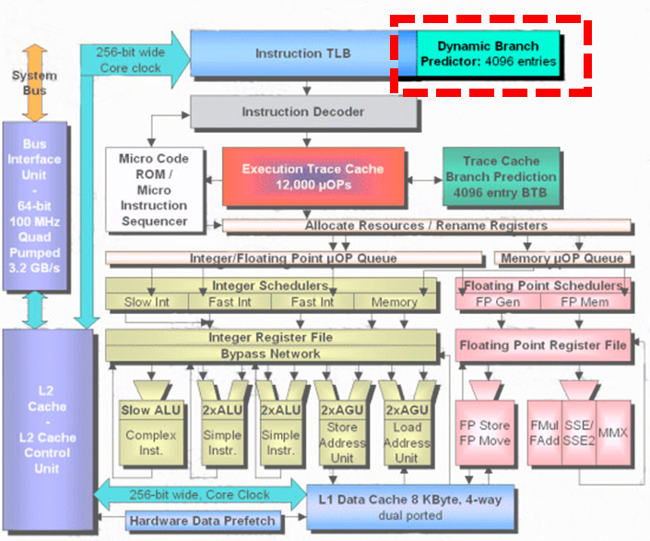
3. Theoretical performance comparative analysis
Theoretical performance limits of EPIC
Speculative execution
EPIC: Compiler chooses
Traditional systems: Hardware chooses with Branch Predictor
27.06.2024

Slide 31
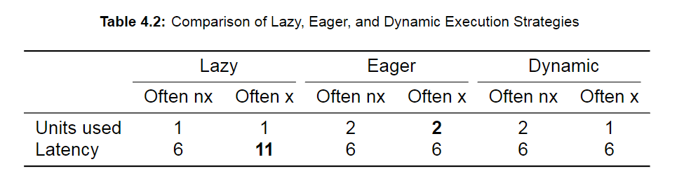
3. Theoretical performance comparative analysis
Theoretical performance limits of EPIC
Speculative execution
EPIC: Compiler chooses
Traditional systems: Hardware chooses with Branch Predictor
Conclusion:
EPIC will either lead to more execution overhead or latency compared to traditional systems
27.06.2024

Slide 32
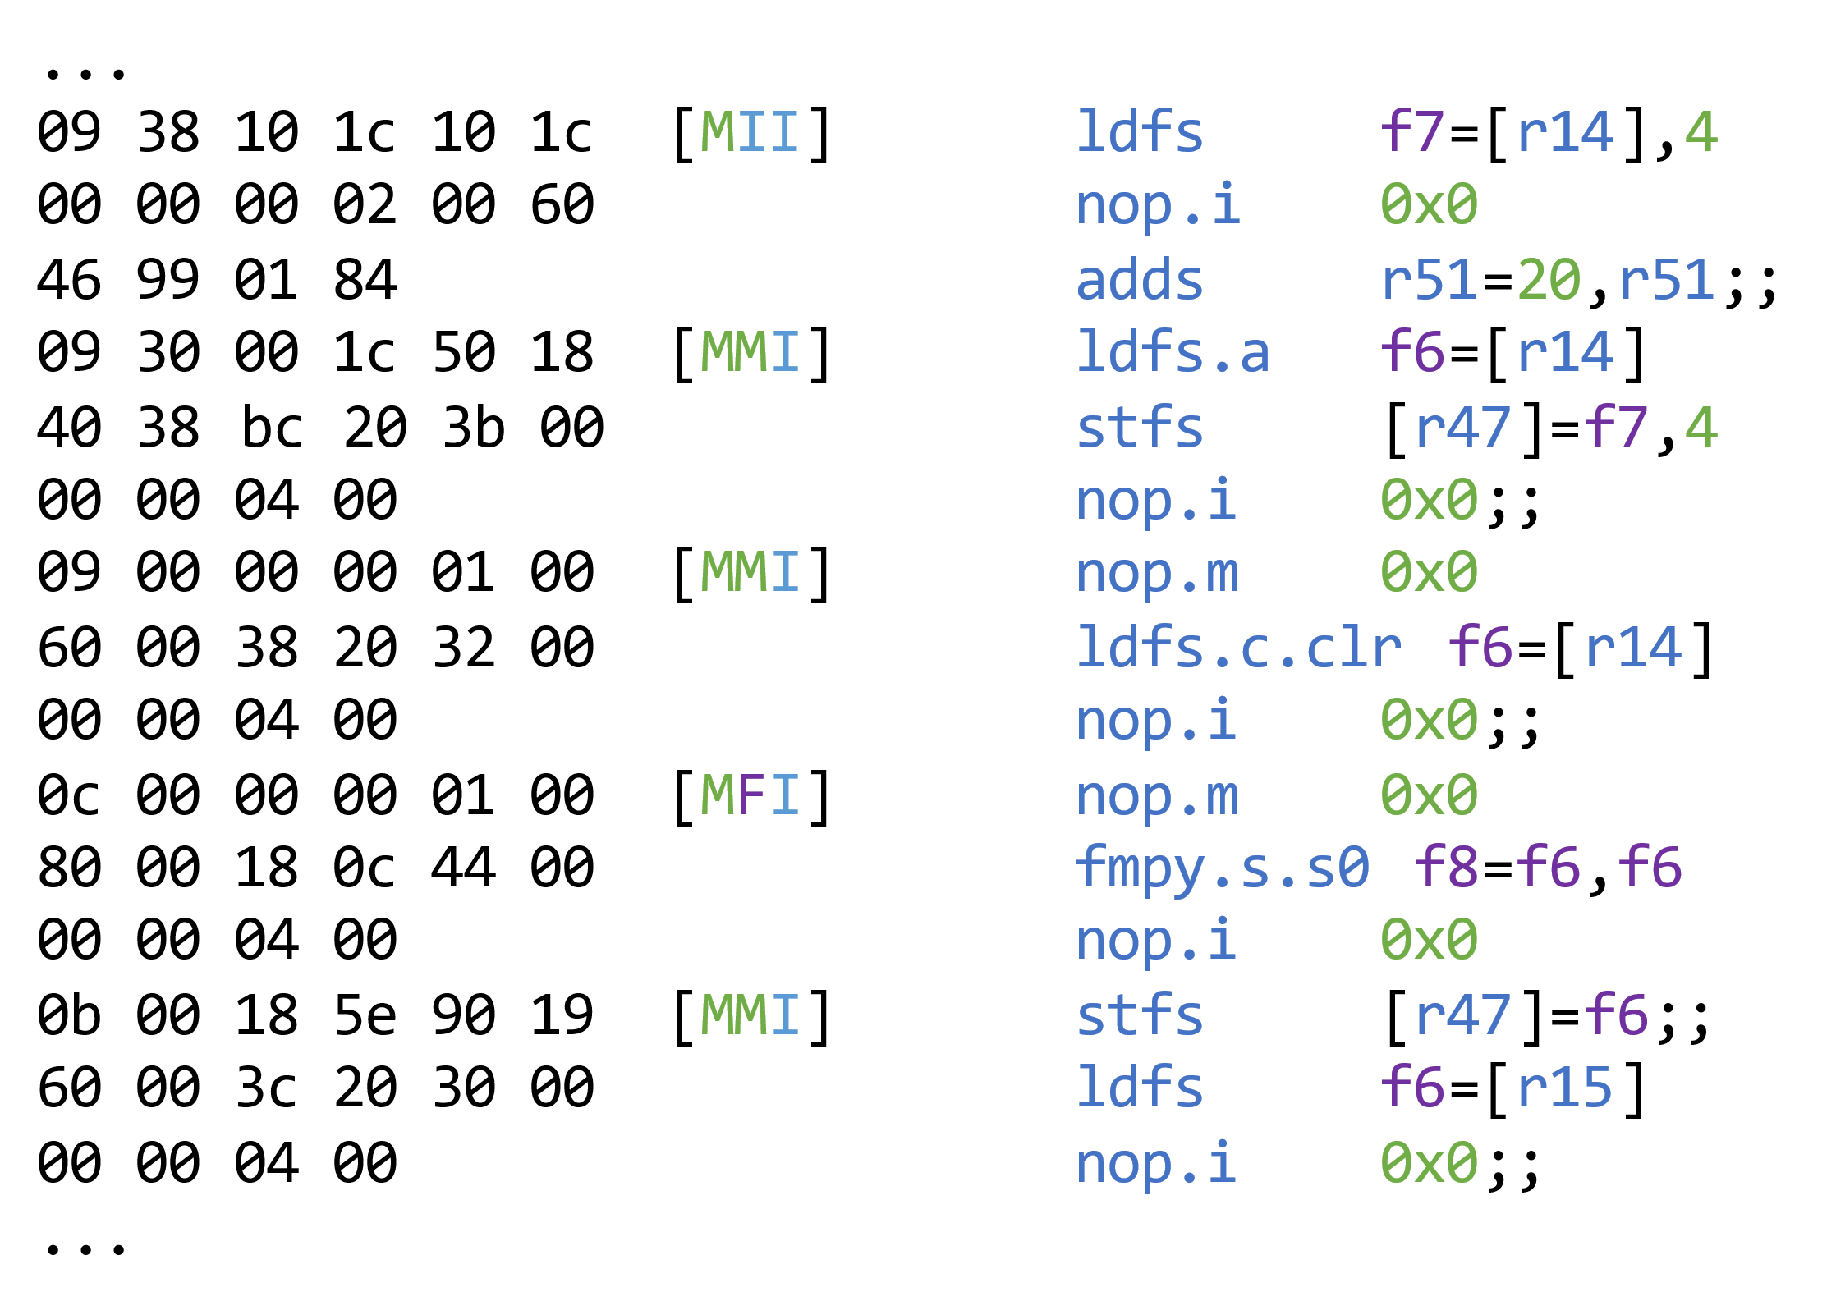
4. Static analysis
27.06.2024

Slide 33


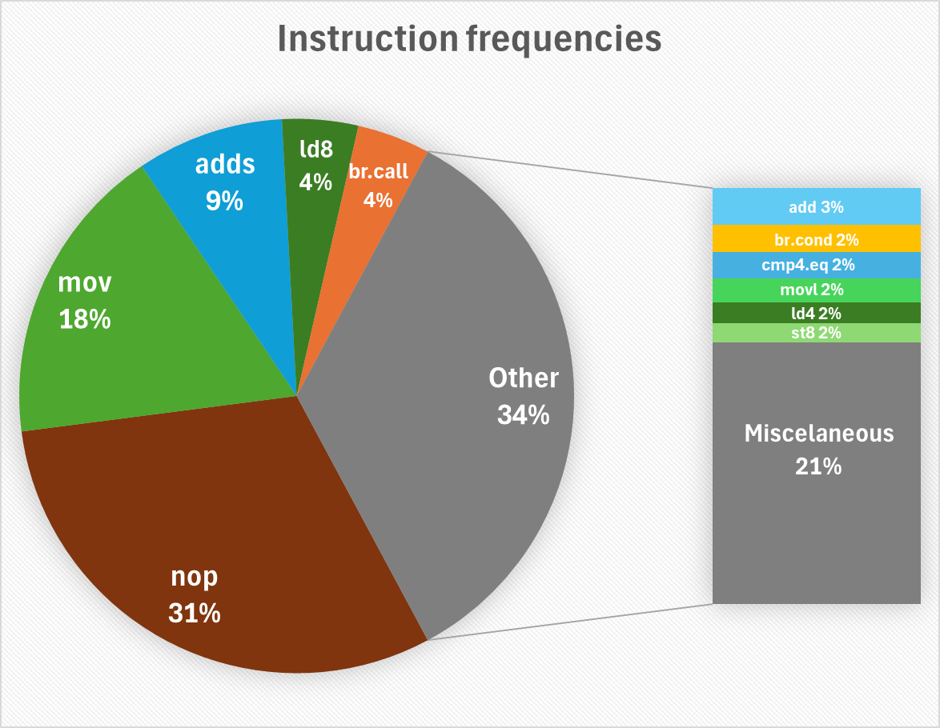
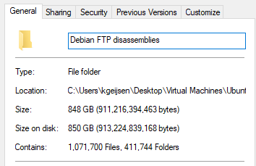
4. Static analysis
Analysis of 1,071,700 files
FTP
disassembly
analysis
27.06.2024

Slide 34
4. Static analysis
Instruction frequencies
Roughly 30% of all instructions are NOPs
27.06.2024

Slide 35
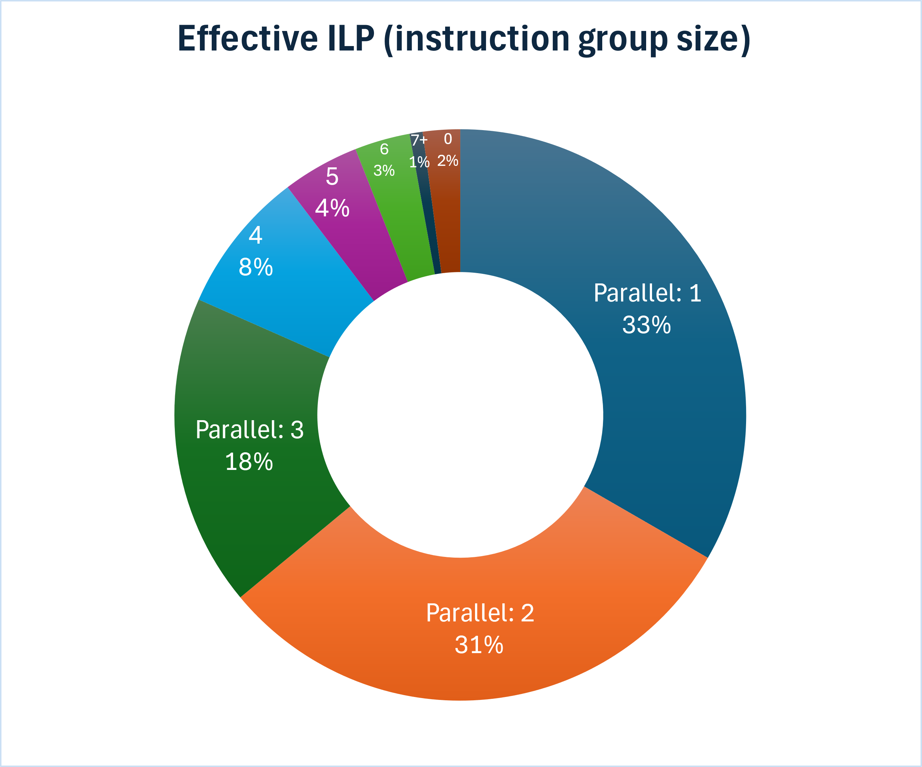
4. Static analysis
Instruction frequencies
Roughly 30% of all instructions are NOPs
Instruction parallelism
Average of 2.3 IPC (instructions per cycle)
27.06.2024

Slide 36
4. Static analysis
Instruction frequencies
Roughly 30% of all instructions are NOPs
Instruction parallelism
Average of 2.3 IPC (instructions per cycle)
Conclusion:
General-purpose code is not highly parallel
27.06.2024

Slide 37
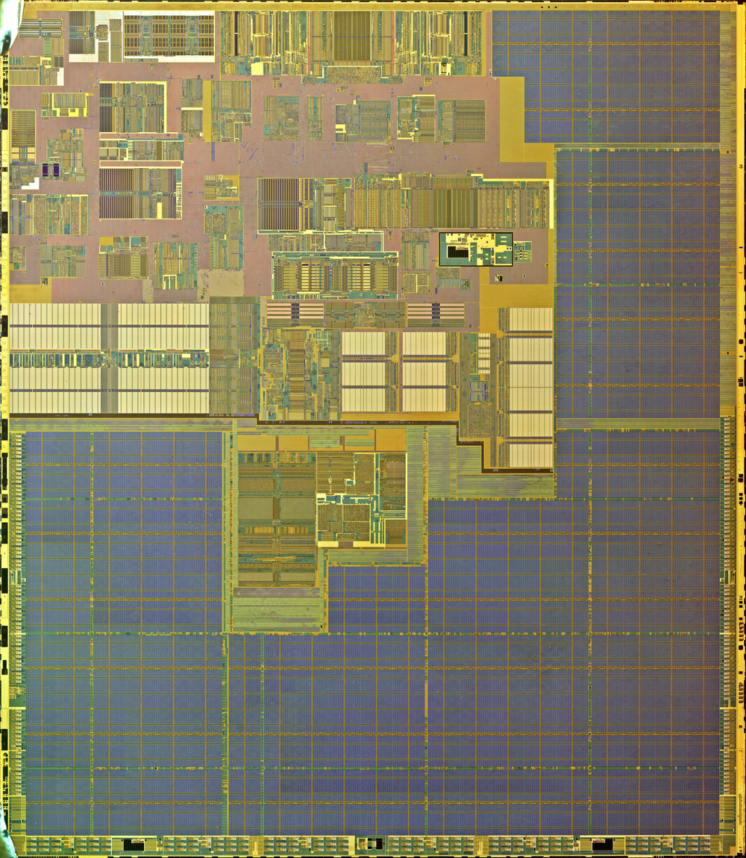
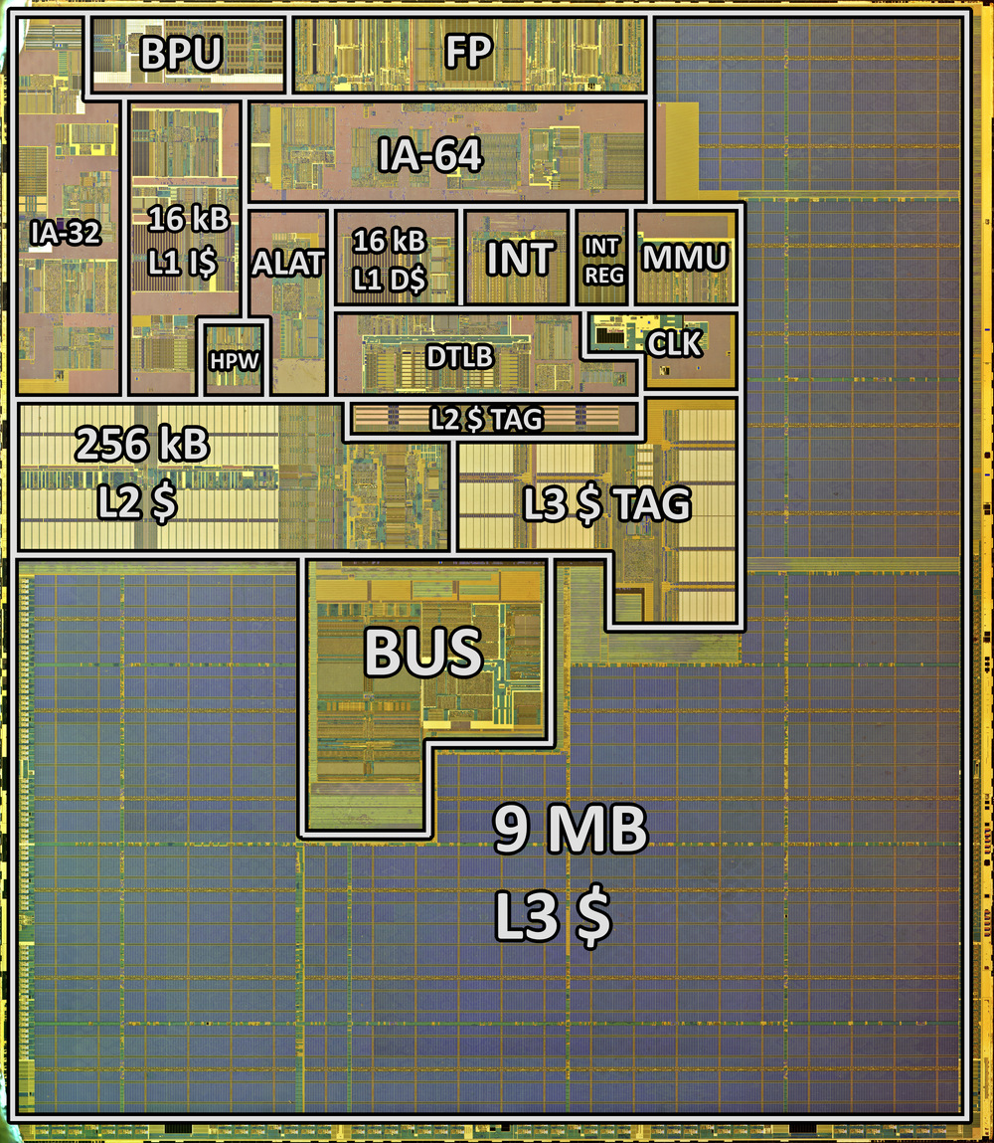
5. Hardware complexity comparative analysis
Creating hardware floorplans
09-10-2020

Slide 38
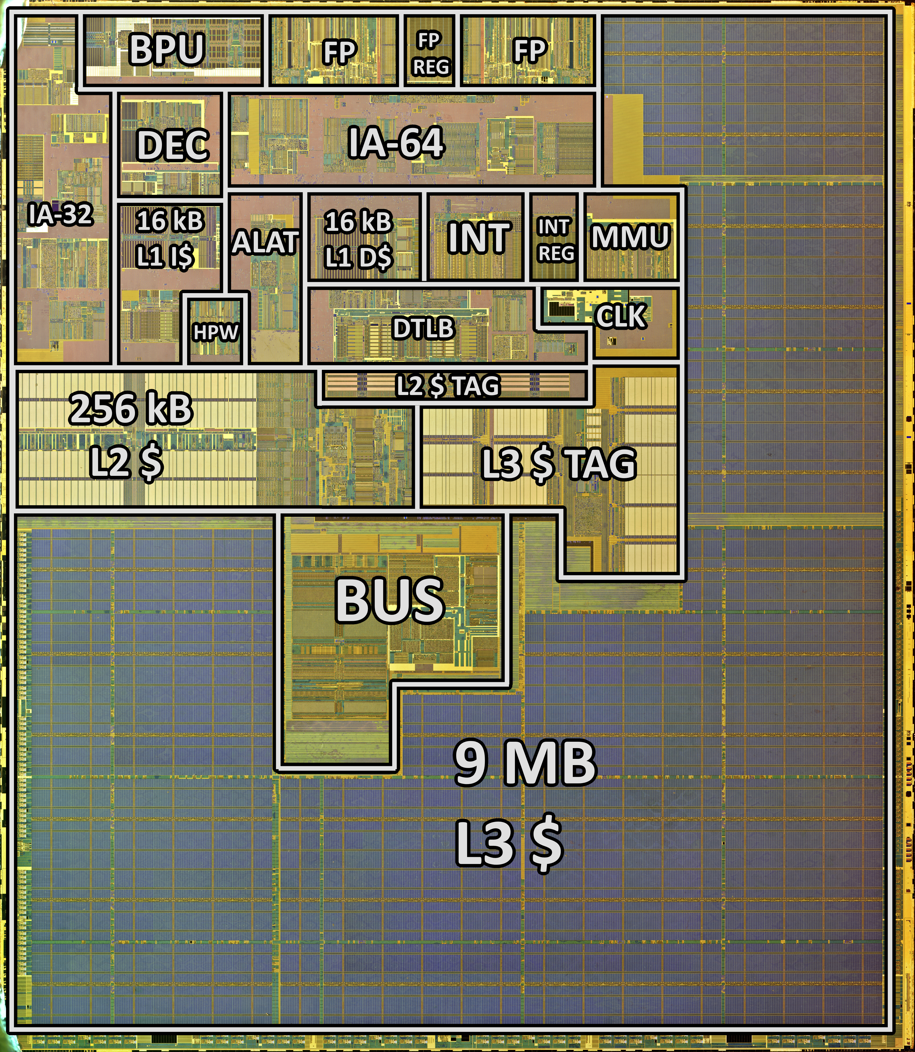
5. Hardware complexity comparative analysis
Creating hardware floorplans
09-10-2020

Slide 39
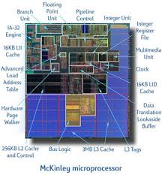
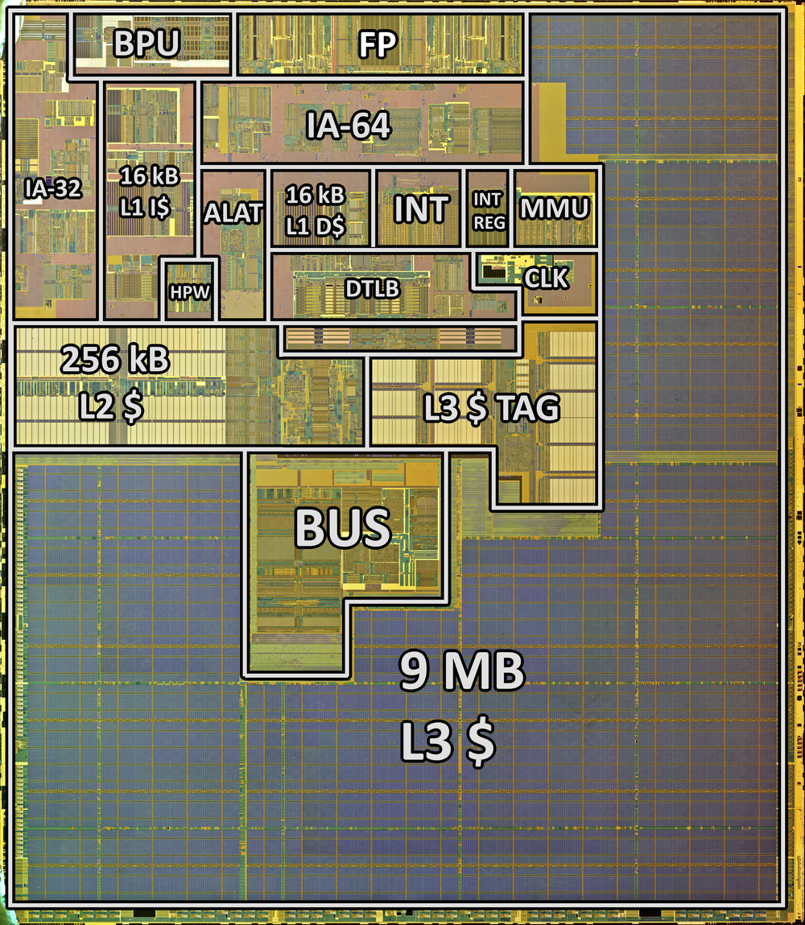
5. Hardware complexity comparative analysis
Deriving hardware floorplans
Existing floorplans
27.06.2024

Slide 40
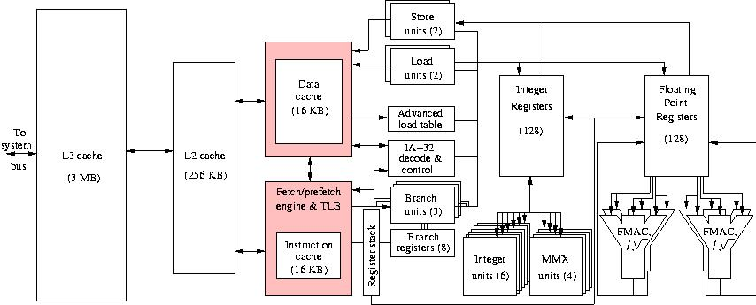
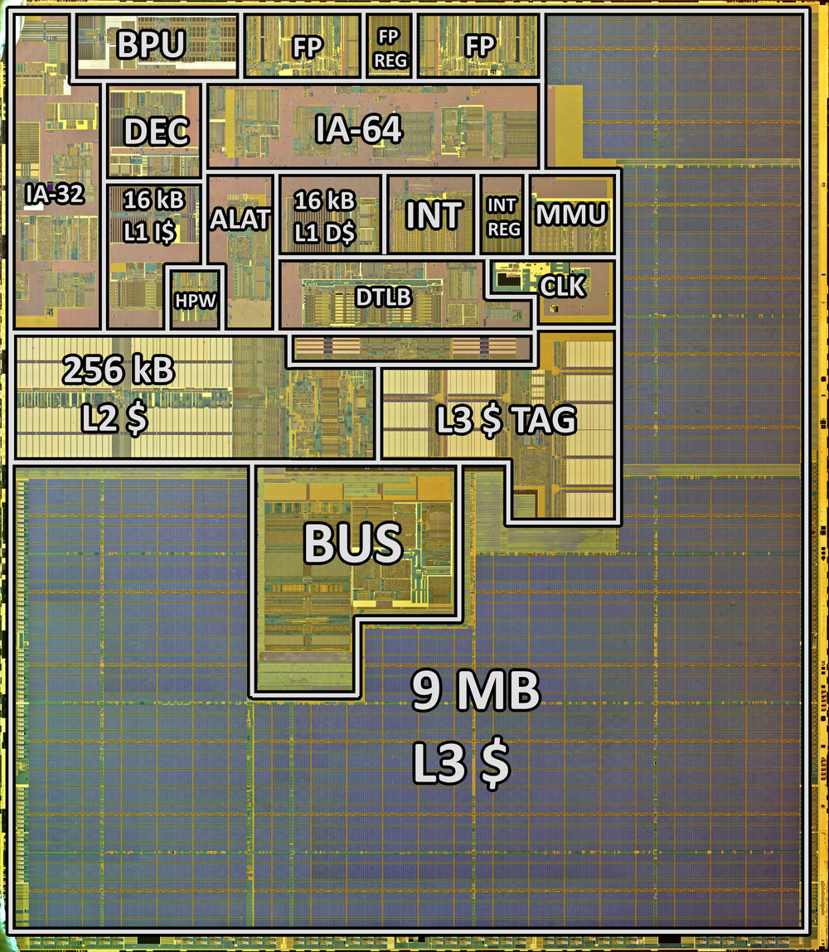
5. Hardware complexity comparative analysis
Deriving hardware floorplans
Existing floorplans
Block diagrams
27.06.2024

Slide 41
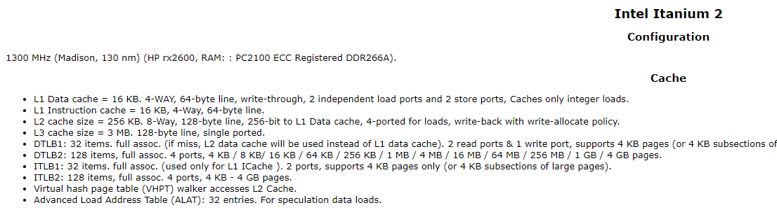
5. Hardware complexity comparative analysis
Deriving hardware floorplans
Existing floorplans
Block diagrams
Specifications datasheets
27.06.2024

Slide 42
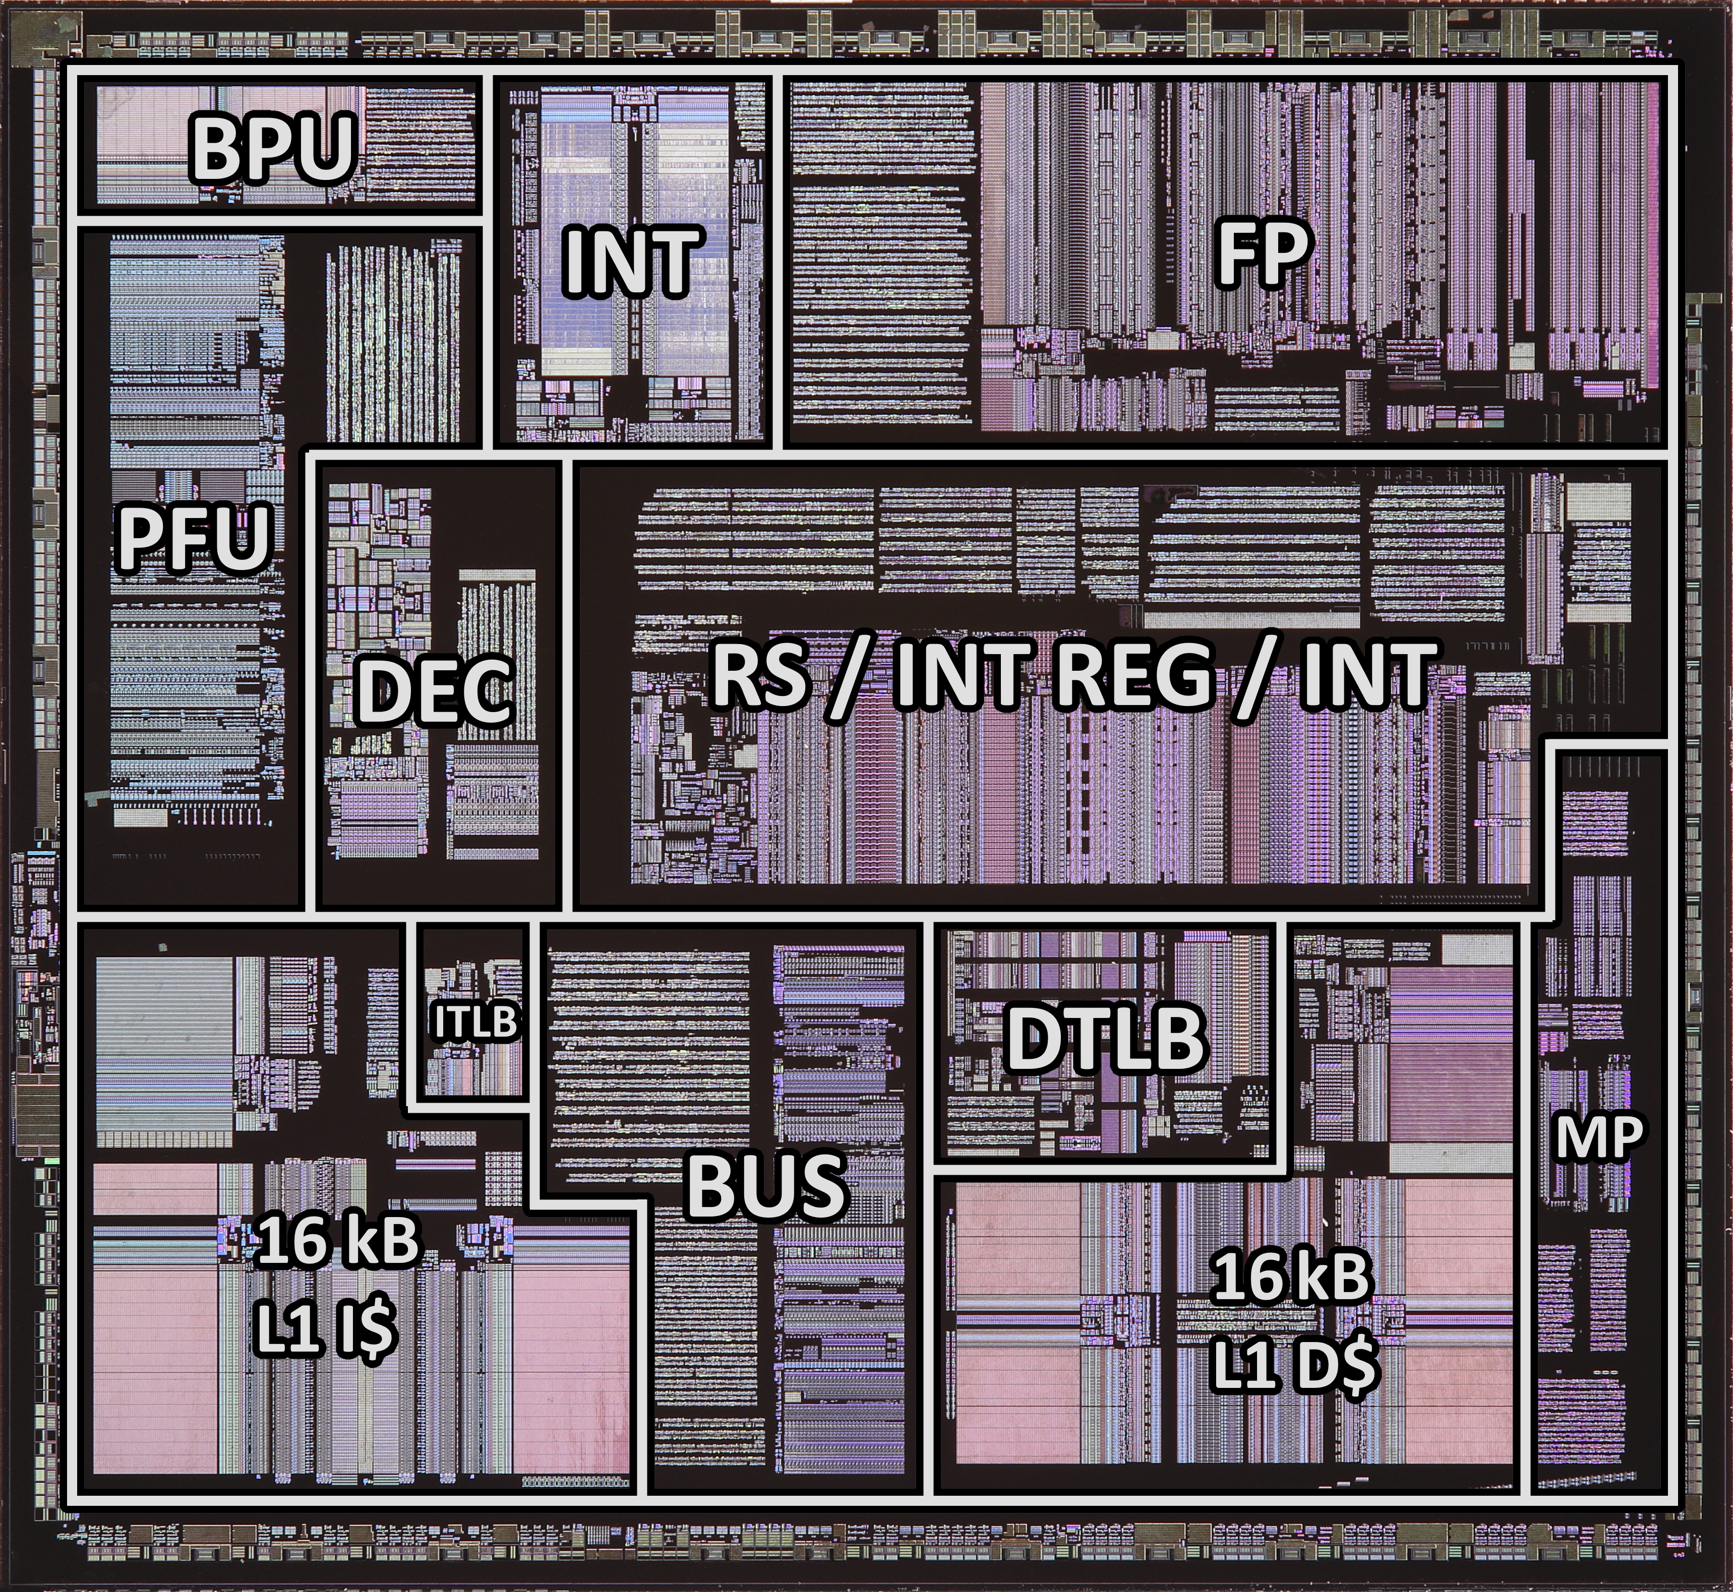
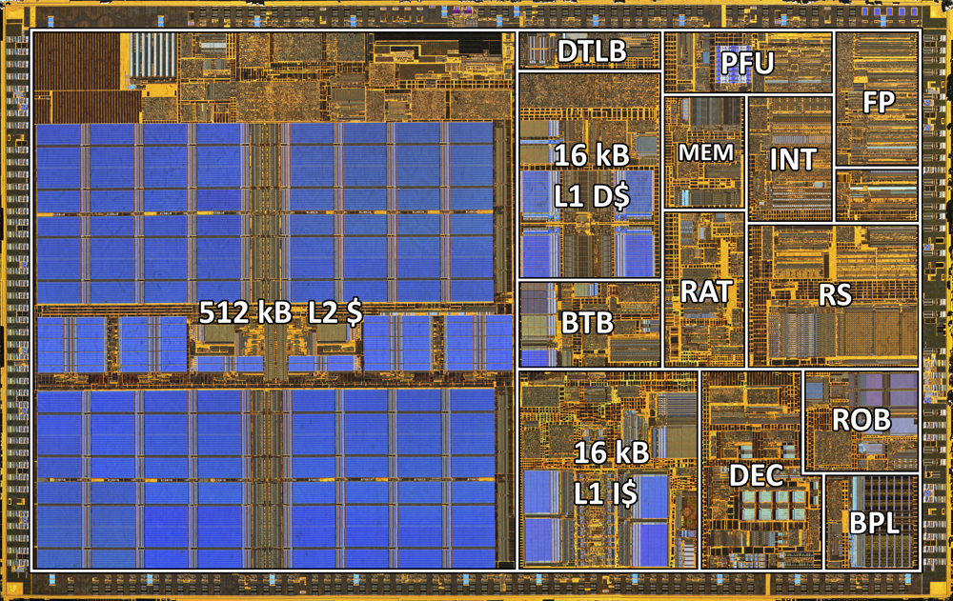
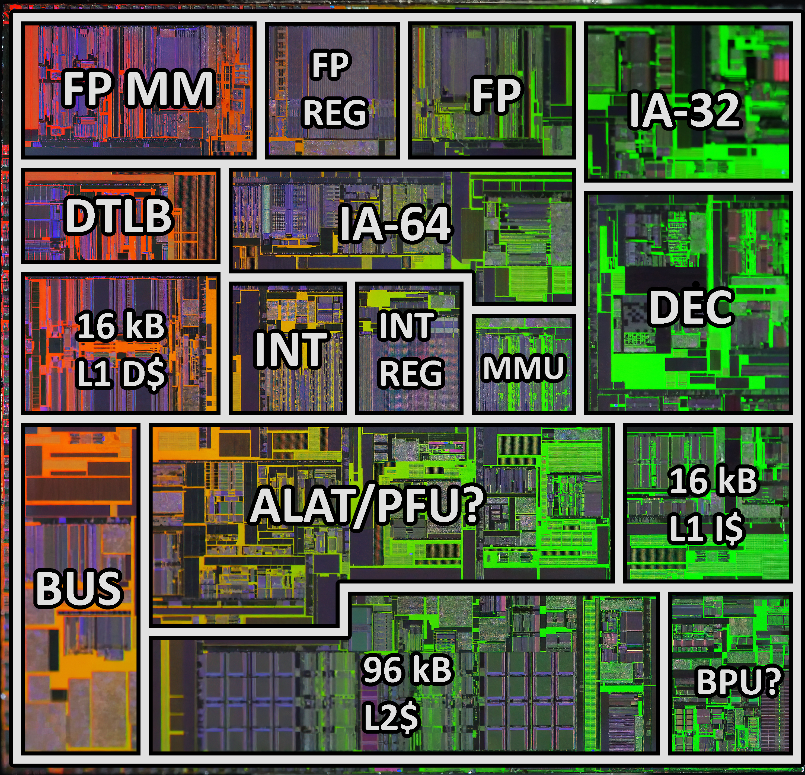
5. Hardware complexity comparative analysis
Intel P5 (Pentium) Intel P6 (Pentium II)
Deriving hardware floorplans
Existing floorplans
Block diagrams
Specifications datasheets
Comparative analysis of four floorplans
Intel Merced (Itanium) Intel Madison (Itanium 2)
09-10-2020

Slide 43
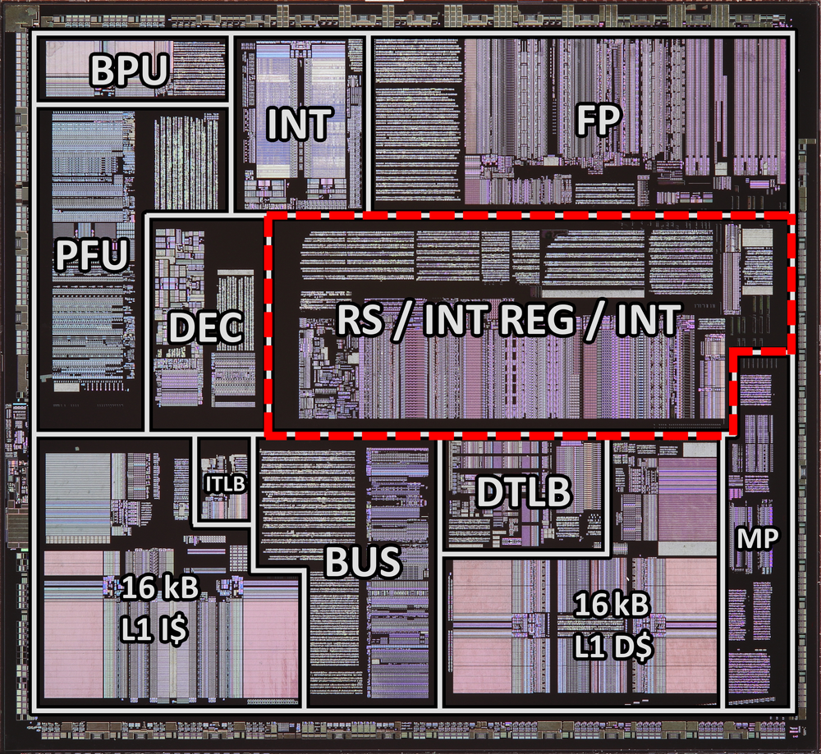
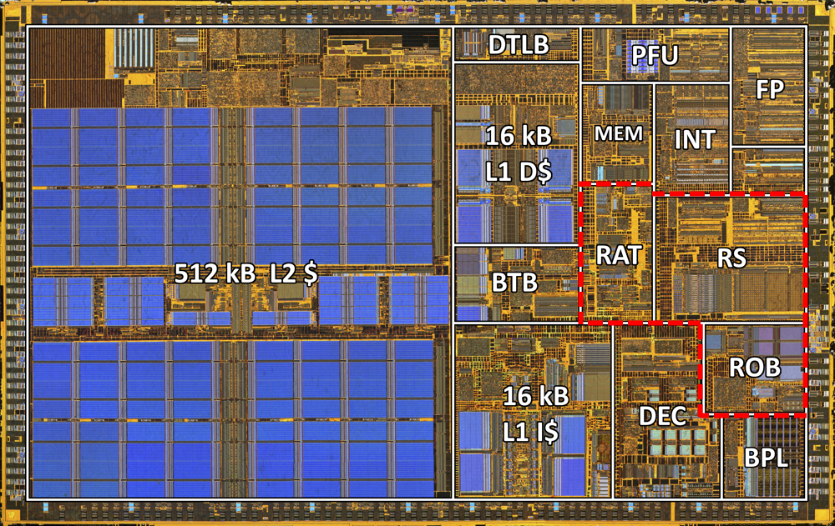
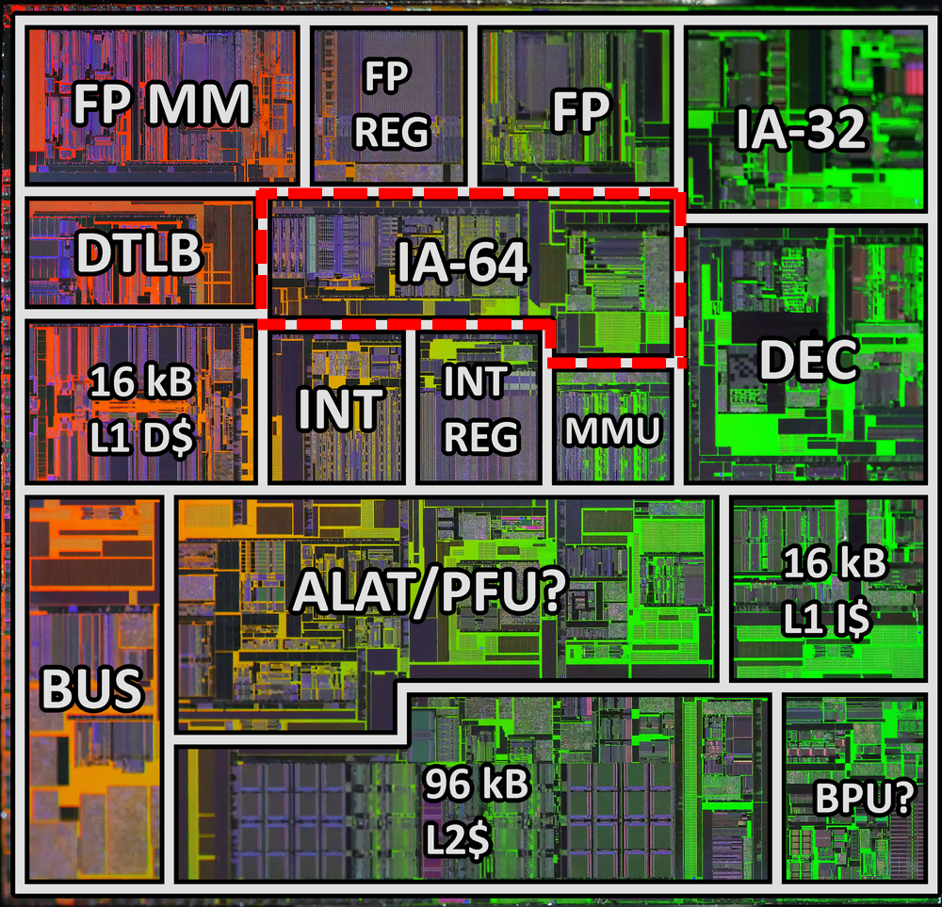

5. Hardware complexity comparative analysis
Intel P5 (Pentium) Intel P6 (Pentium II)
Deriving hardware floorplans
Existing floorplans
Block diagrams
Specifications datasheets
Comparative analysis of four floorplans
Out-of-order complexity is similar to IA-64 scoreboarding
Intel Merced (Itanium) Intel Madison (Itanium 2)
09-10-2020

Slide 44
5. Hardware complexity comparative analysis
Intel P5 (Pentium) Intel P6 (Pentium II)
Deriving hardware floorplans
Existing floorplans
Block diagrams
Specifications datasheets
Comparative analysis of four floorplans
Out-of-order complexity is similar to IA-64 scoreboarding
Conclusion
Itanium’s EPIC only has – at best – marginal hardware improvements
Intel Merced (Itanium) Intel Madison (Itanium 2)
09-10-2020

Slide 45
6. Differentiation strategic framework
Marketing based on differentiation
27.06.2024

Slide 46
6. Differentiation strategic framework
Marketing based on differentiation
Target audience
A b
Compare with competition
Update based on feedback
27.06.2024

Slide 47
6. Differentiation strategic framework
Marketing based on differentiation
Target audience
Either general purpose (replace x86) or data center
Compare with competition
Update based on feedback
Datacenter Needs 2001
64-bit
High performance
Energy efficiency
Cost-effectiveness
Compatibility with existing software
Security features
High reliability (RAS)
Multi-processor scalability
Long-term support
27.06.2024

Slide 48
6. Differentiation strategic framework
Marketing based on differentiation
Target audience
Either general purpose (replace x86) or data center
Compare with competition
What differentiates Itanium?
Update based on feedback
Datacenter Needs 2001 | Itanium | Intel x86 | AMD x86
64-bit | Yes | No | No
High performance | Med-High | High | Med-High
Energy efficiency | Low | Med | Med
Cost-effectiveness | Low | Med | High
Compatibility with existing software | No | Yes | Yes
Security features | Yes | No | No
High reliability (RAS) | Yes | No | No
Multi-processor scalability | Yes | No | No
Long-term support | Yes | Yes | Yes
27.06.2024

Slide 49
6. Differentiation strategic framework
Marketing based on differentiation
Target audience
Either general purpose (replace x86) or data center
Compare with competition
What differentiates Itanium?
Update based on feedback
AMD64
Datacenter Needs 2003 | Itanium | Intel x86 | AMD x86
64-bit | Yes | No | Yes
High performance | Med | Med | High
Energy efficiency | Low | Med | Med
Cost-effectiveness | Low | Med | High
Compatibility with existing software | No | Yes | Yes
Security features | Yes | No | No
High reliability (RAS) | Yes | No | No
Multi-processor scalability | Yes | No | No
Long-term support | Yes | Yes | Yes
27.06.2024

Slide 50
6. Differentiation strategic framework
Marketing based on differentiation
Target audience
Either general purpose (replace x86) or data center
Compare with competition
What differentiates Itanium?
Update based on feedback
AMD64
Intel Xeon, and EM64T
Datacenter Needs 2004 | Itanium | Intel x86 | AMD x86
64-bit | Yes | Yes | Yes
High performance | Med | High | Med-high
Energy efficiency | Low | Med | Med
Cost-effectiveness | Low | Med | High
Compatibility with existing software | No | Yes | Yes
Security features | Yes | No | No
High reliability (RAS) | Yes | No | No
Multi-processor scalability | Yes | Yes | No
Long-term support | Yes | Yes | Yes
27.06.2024

Slide 51
6. Differentiation strategic framework
Marketing based on differentiation
Target audience
Either general purpose (replace x86) or data center
Compare with competition
What differentiates Itanium?
Update based on feedback
AMD64
Intel Xeon, and EM64T
Normalizing of x86 extensions (XMP, RAS, SMX, etc.)
Datacenter Needs 2010 | Itanium | Intel x86 | AMD x86
64-bit | Yes | Yes | Yes
High performance | Med | High | Med-high
Energy efficiency | Low | Med | Med
Cost-effectiveness | Low | Med | High
Compatibility with existing software | No | Yes | Yes
Security features | Yes | Yes | Yes
High reliability (RAS) | Yes | Yes | Yes
Multi-processor scalability | Yes | Yes | Yes
Long-term support | Uncertainty! | Yes | Yes
27.06.2024

Slide 52
6. Differentiation strategic framework
Marketing based on differentiation
Target audience
Either general purpose (replace x86) or data center
Compare with competition
What differentiates Itanium?
Update based on feedback
AMD64
Intel Xeon, and EM64T
Normalizing of x86 extensions
Conclusion:
It became challenging to market
Datacenter Needs 2010 | Itanium | Intel x86 | AMD x86
64-bit | Yes | Yes | Yes
High performance | Med | High | Med-high
Energy efficiency | Low | Med | Med
Cost-effectiveness | Low | Med | High
Compatibility with existing software | No | Yes | Yes
Security features | Yes | Yes | Yes
High reliability (RAS) | Yes | Yes | Yes
Multi-processor scalability | Yes | Yes | Yes
Long-term support | Uncertainty! | Yes | Yes
27.06.2024

Slide 53
Summary
MSc thesis: Why did Itanium fail?
Explorative study to find the key reason why Itanium failed
Automated sentiment analysis
Popular until ~2004
SPEC performance comparative analysis
Comparable (sometimes better, sometimes worse)
Theoretical performance comparative analysis
Case study of limitation of EPIC compared to traditional systems
Static analysis of IA-64 binaries
Not much ILP to extract from software at compile-time
Hardware analysis
x86 hardware is not much more complex than Itanium
Differentiation business strategy framework
Itanium lost its competitive edge over x86 due to rapid developments from AMD and Intel
09-10-2020

Slide 54
Conclusion
MSc thesis: Why did Itanium fail?
Itanium was supposed to bring 64-bit, ILP and data center features, but the existing x86-family was eventually able to achieve all of these, so the extra investment was not well motivated.
09-10-2020

Slide 55
Discussion
MSc thesis: Why did Itanium fail?
Broader implication of this conclusion
Cautionary tale for innovation companies/projects
How could Itanium have succeeded?
If AMD64 was never introduced
More feedback cycles from real-world implementations (instead of lab-tests)
More focus on OoO in hardware to benefit from dynamic optimizations
Defeats the purpose of EPIC, but could save the project to bring the same competitive performance
Find or create niche market to build ecosystem
09-10-2020

Slide 56
Thank you for your attention
Kamron Geijsen

